Slide 1


Workflow & tasks
collecting data | scraping data when released as HTML tables | turning pdf reports into well structured data (data journalism team)
processing data | merge data sets released by different pharmaceutical companies deduplication / person matching setting up data base | validation of extracted data sets (data journalism team)
reporting | extensive data base articles | compact data base interactive map articles (science / health department)
 | collaborative reporting

Slide 2
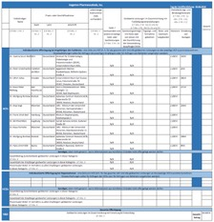
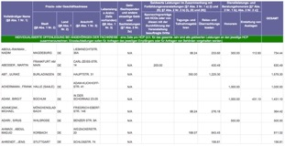
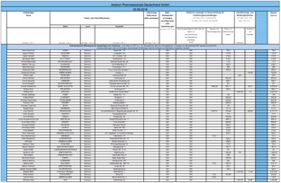
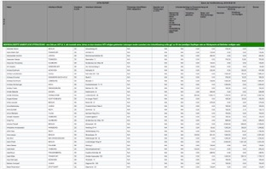
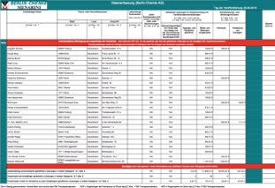
Turn nasty pdf-files into clean, well-structured data
different layout/structures
password protected pdf-files
some deliberately ill-structured
some image pdfs
As if they wanted the data to be trapped...
Workflow: (Remove password protection) – (OCR) – Extracing data from pdf (Tabula) - Validating/correcting extraction (Excel / R)
Want to hear & learn more about this → Stay for the workshop 15:15 – 16:15

Slide 3
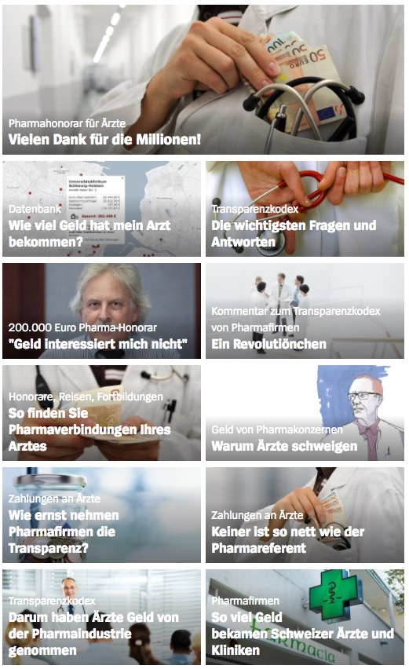
How to present the findings?
Overview
Search in database + map
FAQ
Story / confrontation
Opinion piece
Bigger picture / explainer
Individual cases

Slide 4
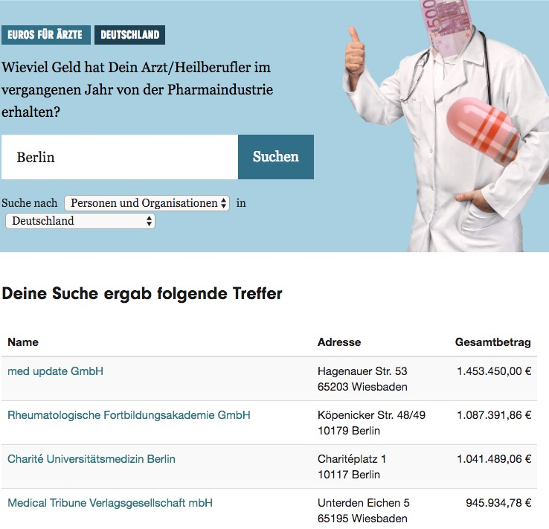
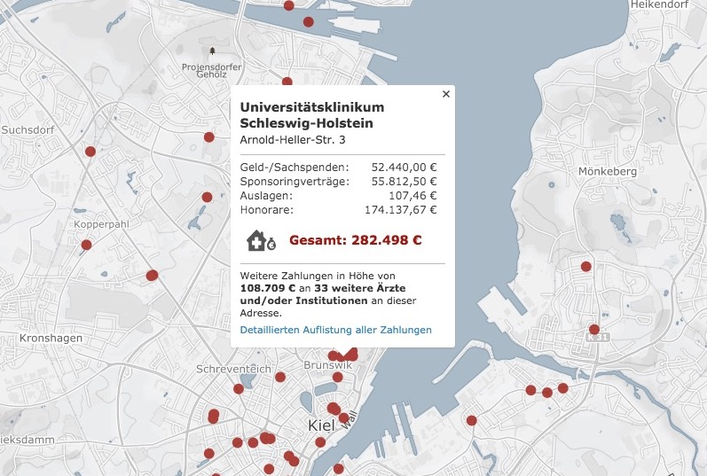
What readers are most interested in
Finding their doctor(s)
→ Enormous traffic on data base and map based search

Slide 5
Outcome
Readers
High interest, mostly positive, encouraging feedback
Doctors
Mixed feedback, frustration with current transparency regulations and how education is dominated by pharmaceutical companies
Lawyers
Numerous complaints, systematic targeting of doctors by at least one legal practice. But: republication of transparency reports, that are based on individual consent is legal
Politics
no changes

